Slide 1
APB PROTOCOL
Name: G. Vamsi Girish
M.Tech: NIT Trichy VLSI Systems

Slide 2
Content
AMBA Bus Architecture.
APB Interface Diagram.
Operation Of APB.
PIN Description.
Master Simulation Result.
APB Interface Diagram with two slaves.
Summary of APB Protocol.

Slide 3
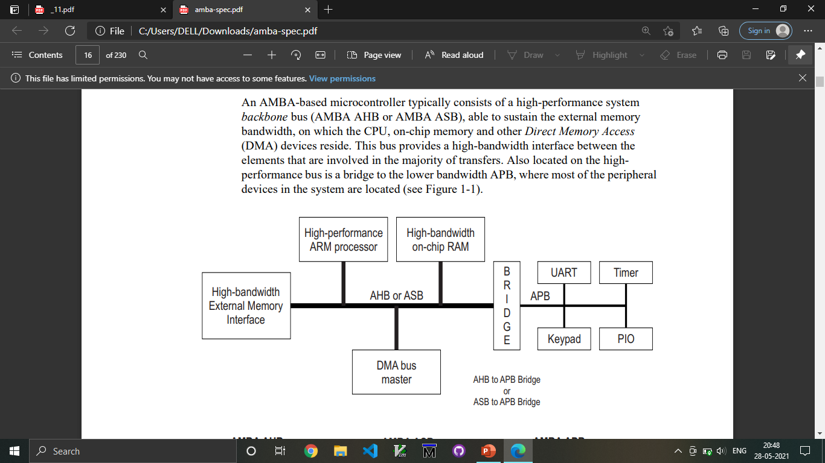
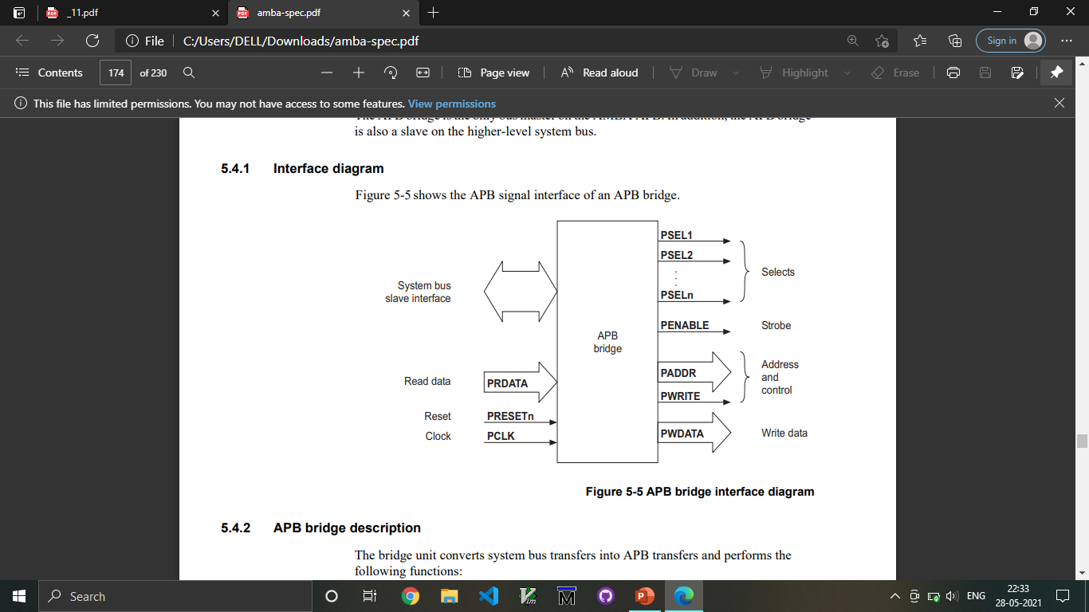
AMBA ARCHITECTURE

Slide 4
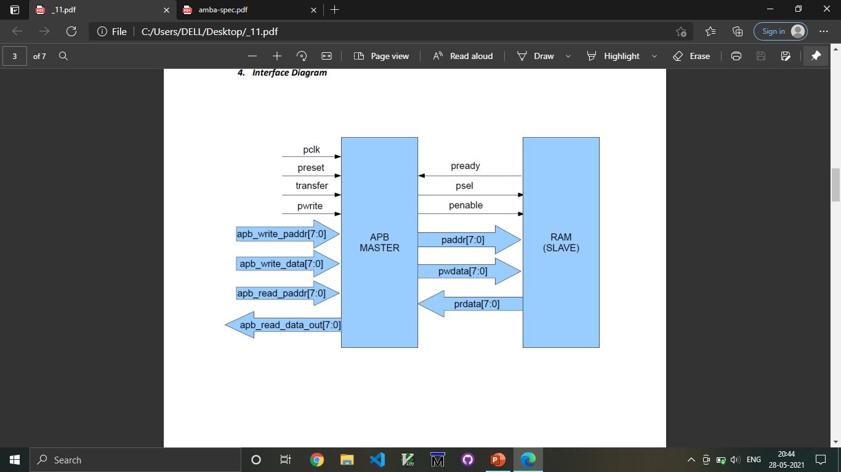
Interface Diagram
PCLK
PWRITE
PRESETn
PREADY
transfer
PSEL1
READ_WRITE
PENABLE
Dummy Signals

Slide 5
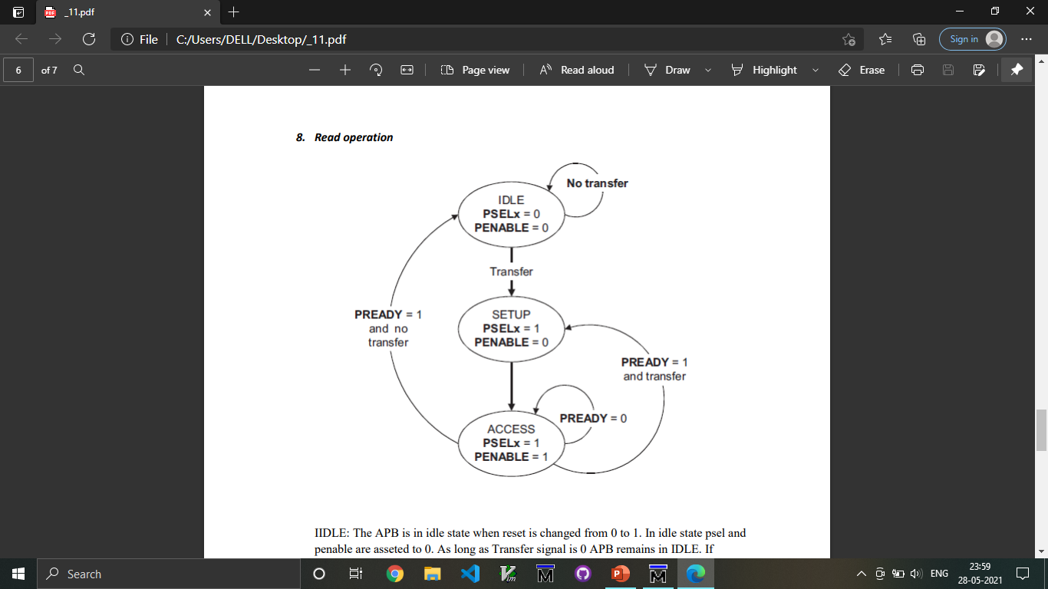
Operation of APB
IDLE
SETUP
ACCESS/ENABLE

Slide 6
PIN Description
SIGNAL | SOURCE | Description | WIDTH(Bit)
Transfer | System Bus | APB enable signal. If high APB is activated else APB is disabled | 1
PCLK | Clock Source | All APB functionality occurs at rising edge. | 1
PRESETn | System Bus | An active low signal. | 1
PADDR | APB bridge | The APB address bus can be up to 32 bits. | 8
PSEL1 | APB bridge | There is a PSEL for each slave. It’s an active high signal. | 1
PENABLE | APB bridge | It indicates the 2nd cycle of a data transfer. It’s an active high signal. | 1
PWRITE | APB bridge | Indicates the data transfer direction. PWRITE=1 indicates APB write access(Master to slave) PWRITE=0 indicates APB read access(Slave to master) | 1
PREADY | Slave Interface | This is an input from Slave. It is used to enter access state. | 1
PSLVERR | Slave Interface | This indicates a transfer failure by the slave. | 1
PRDATA | Slave Interface | Read Data. The selected slave drives this bus during read operation | 8
PWDATA | Slave Interface | Write data. This bus is driven by the peripheral bus bridge unit during write cycles when PWRITE is high. | 8

Slide 7
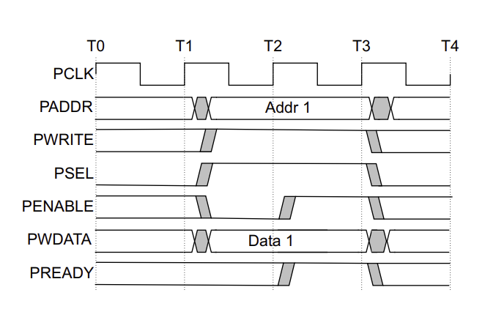
Write transfers
• With no wait states
• With wait states
At T0 phase all are in initial state and slave as selscted.
The Setup phase of the write transfer occurs at T1 phase. The select signal, PSEL, is asserted, which means that PADDR, PWRITE, and PWDATA must be valid.
The Access phase of the write transfer is shown at T2 where PENABLE is asserted. PREADY is asserted by the Completer at the rising edge of PCLK to indicate that the write data will be accepted at T3. PADDR, PWDATA, and any other control signals, must be stable until the transfer completes. At the end of the transfer, PENABLE is de_asserted. PSEL is also de_asserted, unless there is another transfer to the same peripheral.
Clocking gating : using this clocking method in enable and slave select having one clock pulse delay.
With no wait states

Slide 8
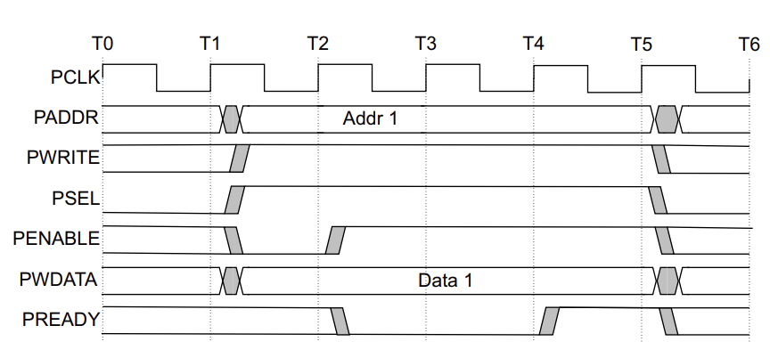
With wait states
During an Access phase, when PENABLE is HIGH, the Completer extends the transfer by driving PREADY LOW. The following signals remain unchanged while PREADY remains LOW: • Address signal, PADDR • Direction signal, PWRITE • Select signal, PSELx • Enable signal, PENABLE • Write data signal, PWDATA • Write strobe signal, PSTRB • Protection type signal, PPROT • User request attribute, PAUSER • User write data attribute, PWUSER PREADY can take any value when PENABLE is LOW. This ensures that peripherals that have a fixed two cycle access can tie PREADY HIGH.

Slide 9
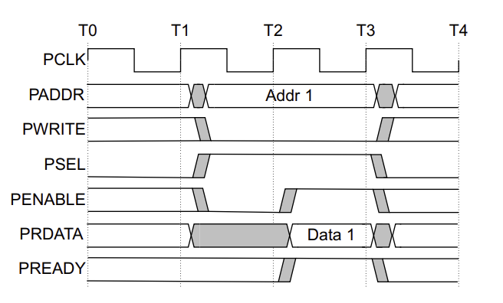
Read transfers
Two types of read transfer are described in this section:
• With no wait states.
• With wait states
All signals shown in this section are sampled at the rising edge of PCL
With no wait states

Slide 10
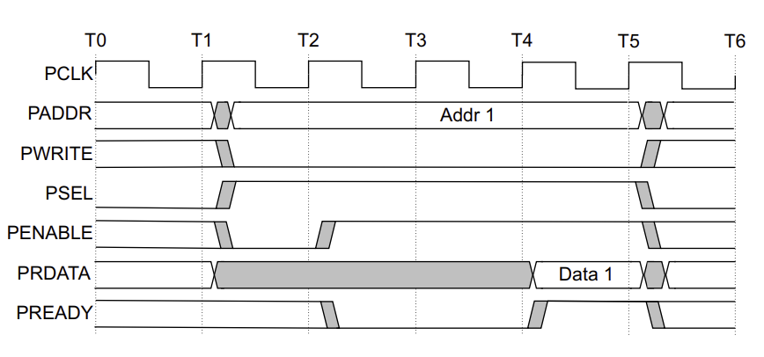
With wait states
The transfer is extended if PREADY is driven LOW during an Access phase. The following signals remain unchanged while PREADY remains LOW: • Address signal, PADDR • Direction signal, PWRITE • Select signal, PSEL • Enable signal, PENABLE • Protection signal, PPRO
With wait states

Slide 11
Error response
Error response comes when data read or write not happen properly.
Throughout access phase data address select line should not change.

Slide 12
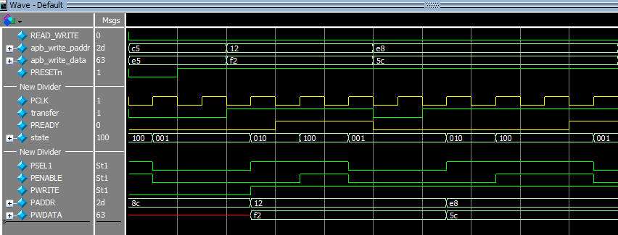
Master Write Operation
Write without wait state
Write with wait state
IDLE State
SETUP State
ENABLE State
IDLE State
SETUP State
ENABLE State
Input Signals
Output Signals

Slide 13
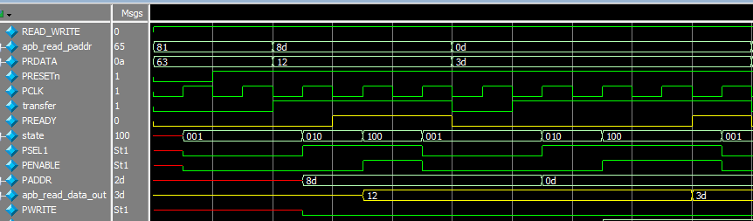
Master Read Operation
Read without wait state
Read with wait state
SETUP
State
ENABLE
State
IDLE State
IDLE State
SETUP State
ENABLE State
Input Signals
Output Signals

Slide 14
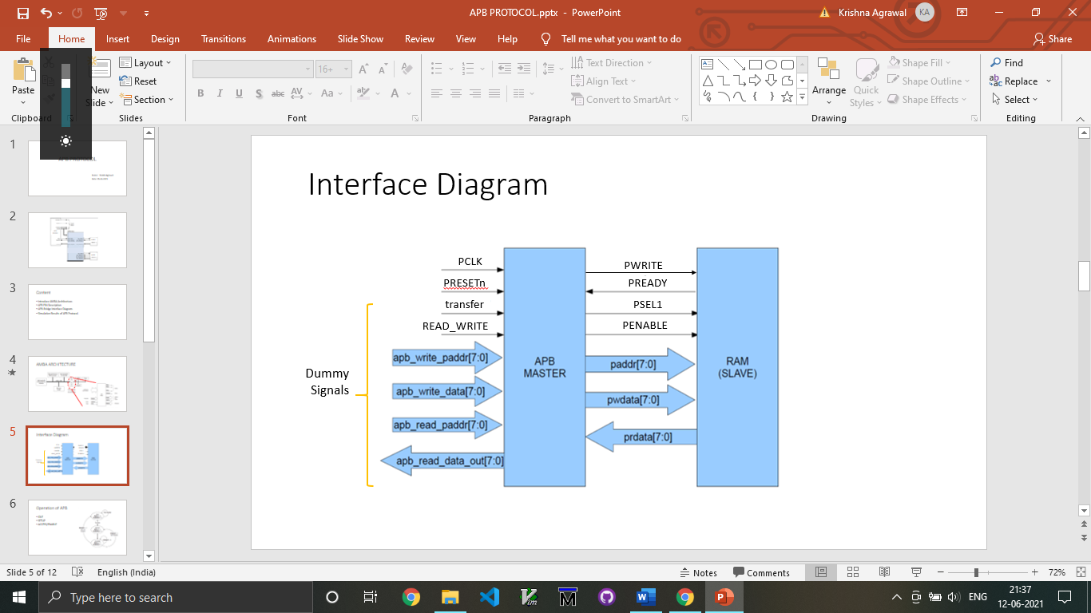
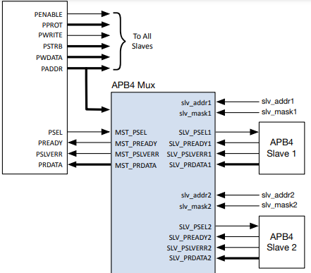
APB Interface with Slaves
APB Master
APB2
APB2

Slide 15
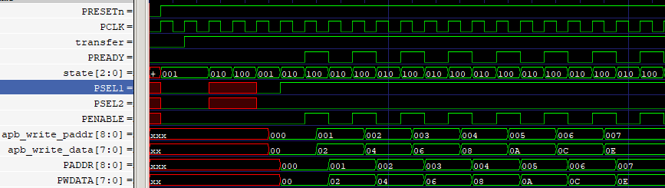
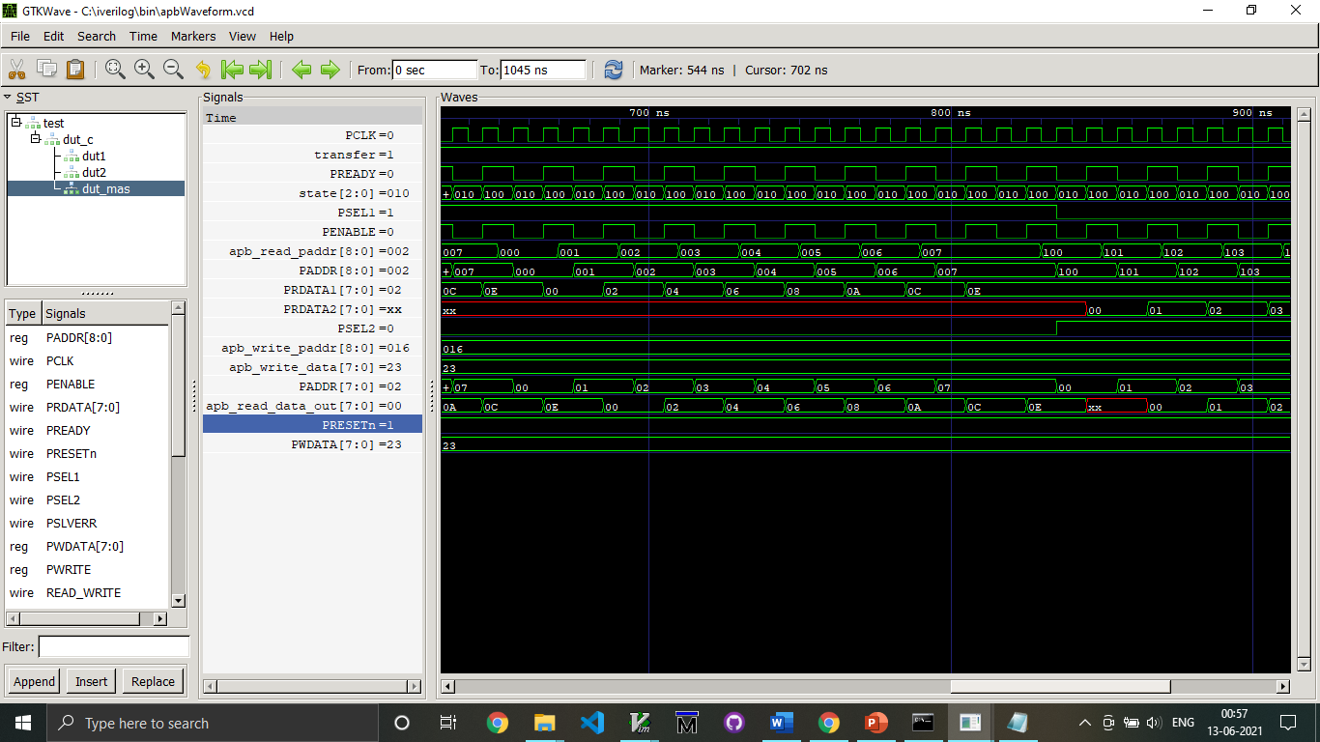
Read-Write Operation – Slave 1
Write
Operation
Read
Operation

Slide 16
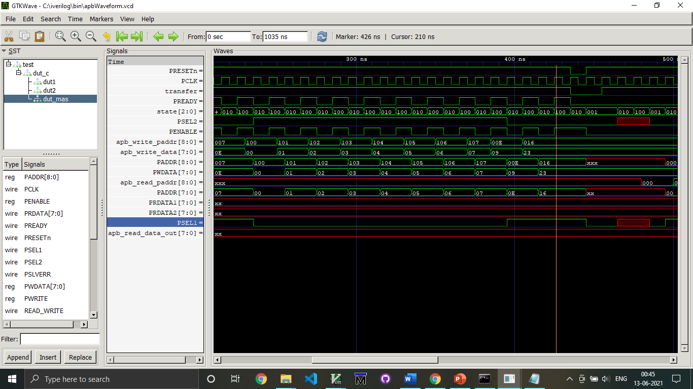
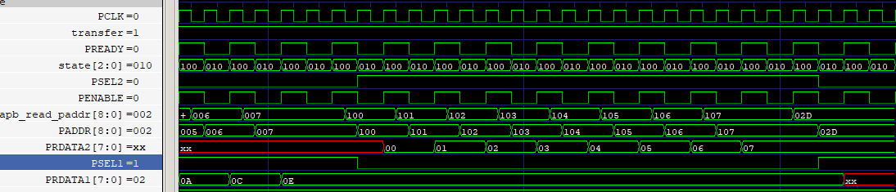
Read-Write Operation – Slave 2
Write
Operation
Read
Operation

Slide 17
Summary
Advantages:
Easy to implement.
Low power consumption and area also very less.
Disadvantages: 1.APB having very less bandwidth and throughput.
2. Used for Lower-level modules only.
3. APB protocol not accepted Pipelining concept.

